Slide 1
DATA ANALYTICS PROJECT
BRIGHT COFFEE SHOP
SALES ANALYSIS
Understanding sales performance from January to June 2023
Project Presentation
Prepared by: Neo Kole
Tools: SQL • Excel • Databricks

Slide 2
Presentation Overview
A clear walkthrough from business question to actionable findings.
• Business context and project objectives
• Dataset overview and data preparation
• Tools and analytical approach
• Key performance indicators
• Sales trends and visual analysis
• Recommendations, limitations and conclusion
REPORTING PERIOD
Jan – Jun 2023
ANALYSIS FOCUS
Sales performance
OUTPUT
Dashboard + insights
BRIGHT COFFEE SHOP SALES ANALYSIS | JAN–JUN 2023 02

Slide 3
1. Business Context
Why analyse coffee shop sales?
Coffee shops generate transactions throughout the day, across products and locations. Sales data can help managers understand what is working and where attention may be needed.
SCOPE
6 months
Business questions
• How much revenue was generated during the period?
• How did revenue change month by month?
• How can sales be compared by store, product category and time?
• What decisions could improve sales planning?
LOCATIONS
3 stores
PRODUCT RANGE
80 products
BRIGHT COFFEE SHOP SALES ANALYSIS | JAN–JUN 2023 03

Slide 4
2. Project Objectives
The project turns transaction-level data into useful business information.
• Explore the sales dataset and understand its structure.
• Prepare and process the data for analysis.
• Use SQL to calculate sales measures and summarise results.
• Use Excel pivot tables and charts to compare performance.
• Build a dashboard that presents the main KPIs and trends.
• Translate the analysis into practical recommendations.
BRIGHT COFFEE SHOP SALES ANALYSIS | JAN–JUN 2023 04

Slide 5
3. Dataset Overview
The dataset covers coffee shop transactions from 1 January to 30 June 2023.
TRANSACTION ROWS
PRODUCTS
STORES
CATEGORIES
149,116
80
3
9
Main fields
Analysis period
• Transaction ID, date and time
• Quantity and unit price
• Store ID and store location
• Product ID, category, type and detail
January – June 2023
Six complete calendar months
The dataset supports analysis by time, store, product and category.
BRIGHT COFFEE SHOP SALES ANALYSIS | JAN–JUN 2023 05

Slide 6
4. Data Preparation
Preparing consistent data is essential before calculating KPIs.
Load
Import the source CSV into the analysis environment.
01
Inspect
Review columns, data types, dates, quantities and prices.
02
Clean
Check formatting and handle price representation consistently.
03
Transform
Create revenue using quantity × unit price.
04
Validate
Compare totals and check that calculations are reasonable.
05
Derived measure: Revenue = transaction quantity × unit price
BRIGHT COFFEE SHOP SALES ANALYSIS | JAN–JUN 2023 06

Slide 7
5. Tools and Analytical Workflow
Each tool supports a different part of the analysis.
SQL / DATABRICKS
MICROSOFT EXCEL
Query, aggregate and analyse transaction data.
Process data, build pivot tables and create charts.
DASHBOARD
POWERPOINT
Present KPIs and comparisons in a single view.
Communicate findings and recommendations.
Workflow: Source data → Prepare → Query → Summarise → Visualise → Recommend
BRIGHT COFFEE SHOP SALES ANALYSIS | JAN–JUN 2023 07

Slide 8
6. Key Performance Indicators
Headline results for the six-month reporting period.
TOTAL REVENUE
TRANSACTIONS
UNITS SOLD
698,812.33
149,116
214,470
Revenue calculated from quantity × unit price
Transaction count
Total quantity sold
UNIQUE PRODUCTS
STORES
80
3
Distinct product count
Astoria, Hell's Kitchen, Lower Manhattan
These KPIs establish the overall scale of sales before comparing performance across months, stores and products.
BRIGHT COFFEE SHOP SALES ANALYSIS | JAN–JUN 2023 08

Slide 9
7. Monthly Revenue Trend — What the Data Shows
Monthly values used to identify the trend.
Lowest month
February: 76,145.19
Highest month
June: 166,485.88
February
June
166,485.88
BRIGHT COFFEE SHOP SALES ANALYSIS | JAN–JUN 2023 10

Slide 10
8. Store, Category and Time Analysis
The dashboard is designed to compare the main sales dimensions.
STORE COMPARISON
CATEGORY ANALYSIS
TIME ANALYSIS
3 locations
9 categories
Day & time
Compare revenue by store
Compare category contribution
Identify busy periods
Questions to answer from the dashboard
Interpretation note
• Which store generates the most revenue?
• Which categories contribute most to sales?
• How does revenue vary by day and time?
Use the store, category and time charts in the Excel dashboard to support these comparisons. Exact segment rankings should be read from the validated pivot tables.
BRIGHT COFFEE SHOP SALES ANALYSIS | JAN–JUN 2023 11

Slide 11
9. Store, Category and Time Analysis
The dashboard is designed to compare the main sales dimensions.
STORE COMPARISON
CATEGORY ANALYSIS
TIME ANALYSIS
3 locations
9 categories
Day & time
Compare revenue by store
Compare category contribution
Identify busy periods
Questions to answer from the dashboard
Interpretation note
• Which store generates the most revenue?
• Which categories contribute most to sales?
• How does revenue vary by day and time?
Use the store, category and time charts in the Excel dashboard to support these comparisons. Exact segment rankings should be read from the validated pivot tables.
BRIGHT COFFEE SHOP SALES ANALYSIS | JAN–JUN 2023 11

Slide 12
10. SQL Analysis
SQL helps calculate consistent measures from the transaction data.
Core calculations
• Total revenue: SUM(quantity × unit price)
• Units sold: SUM(transaction quantity)
• Transactions: COUNT(DISTINCT transaction_id)
• Store count: COUNT(DISTINCT store_id)
• Monthly analysis: group by month
SELECT
SUM(transaction_qty * unit_price) AS total_revenue,
SUM(transaction_qty) AS units_sold,
COUNT(DISTINCT transaction_id) AS transactions
FROM bright_coffee_shop_sales_dataset;
BRIGHT COFFEE SHOP SALES ANALYSIS | JAN–JUN 2023 12

Slide 13
11. Key Findings
The confirmed results point to a clear upward revenue trend in the later months.
• Total revenue for January–June 2023 was 698,812.33.
• The dataset records 149,116 transactions and 214,470 units sold.
• Monthly revenue was lowest in February at 76,145.19.
• Monthly revenue was highest in June at 166,485.88.
• Revenue increased in each month from March through June.
• Store, category and time charts can help explain where and when sales were generated.
BRIGHT COFFEE SHOP SALES ANALYSIS | JAN–JUN 2023 13

Slide 14
12. Recommendations
Use the analysis to support practical sales and operational decisions.
• Review the reasons behind the February revenue dip and identify whether it was seasonal or operational.
• Investigate what drove the stronger performance in May and June, then test whether those actions can be repeated.
• Use store-level comparisons to direct support and resources where they can have the greatest impact.
• Use category and product performance to guide stock planning and promotions.
• Use day-and-time patterns to plan staffing and service capacity.
• Refresh the dashboard regularly so managers can track changes over time.
BRIGHT COFFEE SHOP SALES ANALYSIS | JAN–JUN 2023 14

Slide 15
13. Limitations and Data Quality
Findings are useful, but should be interpreted within the dataset's scope.
• The reporting period covers six months only; it does not show a full year of seasonality.
• The dataset describes recorded transactions and does not explain causes such as promotions, weather or local events.
• Store, category and time rankings should be confirmed against the final pivot tables before quoting exact values.
• Revenue values are shown without a currency symbol because the currency unit was not confirmed in the supplied summary.
• Data preparation and SQL calculations should be documented so results can be reproduced.
BRIGHT COFFEE SHOP SALES ANALYSIS | JAN–JUN 2023 15

Slide 16
14. Revenue by Store
Verified from the supplied transaction CSV | January–June 2023
Key finding
• Highest revenue: Hell's Kitchen (236,511.17)
• Second: Astoria (232,243.91)
• Third: Lower Manhattan (230,057.25)
The revenue totals are relatively close across the three locations. Compare transactions and units sold as well before deciding what drives the differences.
Source: Bright Coffee Shop Sales dataset (Jan–Jun 2023). Revenue = transaction quantity × unit price; currency not confirmed.

Slide 17
15. Revenue by Product Category
Verified category totals | All nine categories included in the chart
Key finding
• Highest category: Coffee (269,952.45)
• Second: Tea (196,405.95)
• Third: Bakery (82,315.64)
Business implication
Review category contribution alongside stock availability, margins and customer demand before planning promotions.
Source: Bright Coffee Shop Sales dataset (Jan–Jun 2023). Revenue = transaction quantity × unit price; currency not confirmed.

Slide 18
16. Top 10 Products by Revenue
Ranked using product detail and quantity × unit price
What this helps answer
• Which specific product details generate the most revenue?
• Which products may deserve closer stock monitoring?
• Which products could be considered for targeted promotions?
Important: revenue is not the same as profit. Margin and product costs were not included in the dataset.
Source: Bright Coffee Shop Sales dataset (Jan–Jun 2023). Revenue = transaction quantity × unit price; currency not confirmed.

Slide 19
17. Revenue by Time of Day
Time buckets calculated from transaction_time
How to use this result
Compare revenue across the morning, afternoon and evening buckets to support staffing and service planning.
The supplied data records transactions from 06:00 to 20:59. Use the same time boundaries in Excel and SQL so the figures match.
Source: Bright Coffee Shop Sales dataset (Jan–Jun 2023). Revenue = transaction quantity × unit price; currency not confirmed.

Slide 20
18. Executive Summary Dashboard
Verified headline KPIs and monthly revenue | Illustrative layout using actual CSV totals
TOTAL REVENUE
698,812.33
TRANSACTIONS
149,116
UNITS SOLD
214,470
STORES
3
Headline insights
• June was the highest-revenue month.
• February was the lowest-revenue month.
• All three stores contributed similar revenue totals.
• Coffee and Tea were the largest revenue categories.
Use the Excel dashboard for filters and detailed exploration.
Source: Bright Coffee Shop Sales dataset (Jan–Jun 2023). Revenue = transaction quantity × unit price; currency not confirmed.

Slide 21
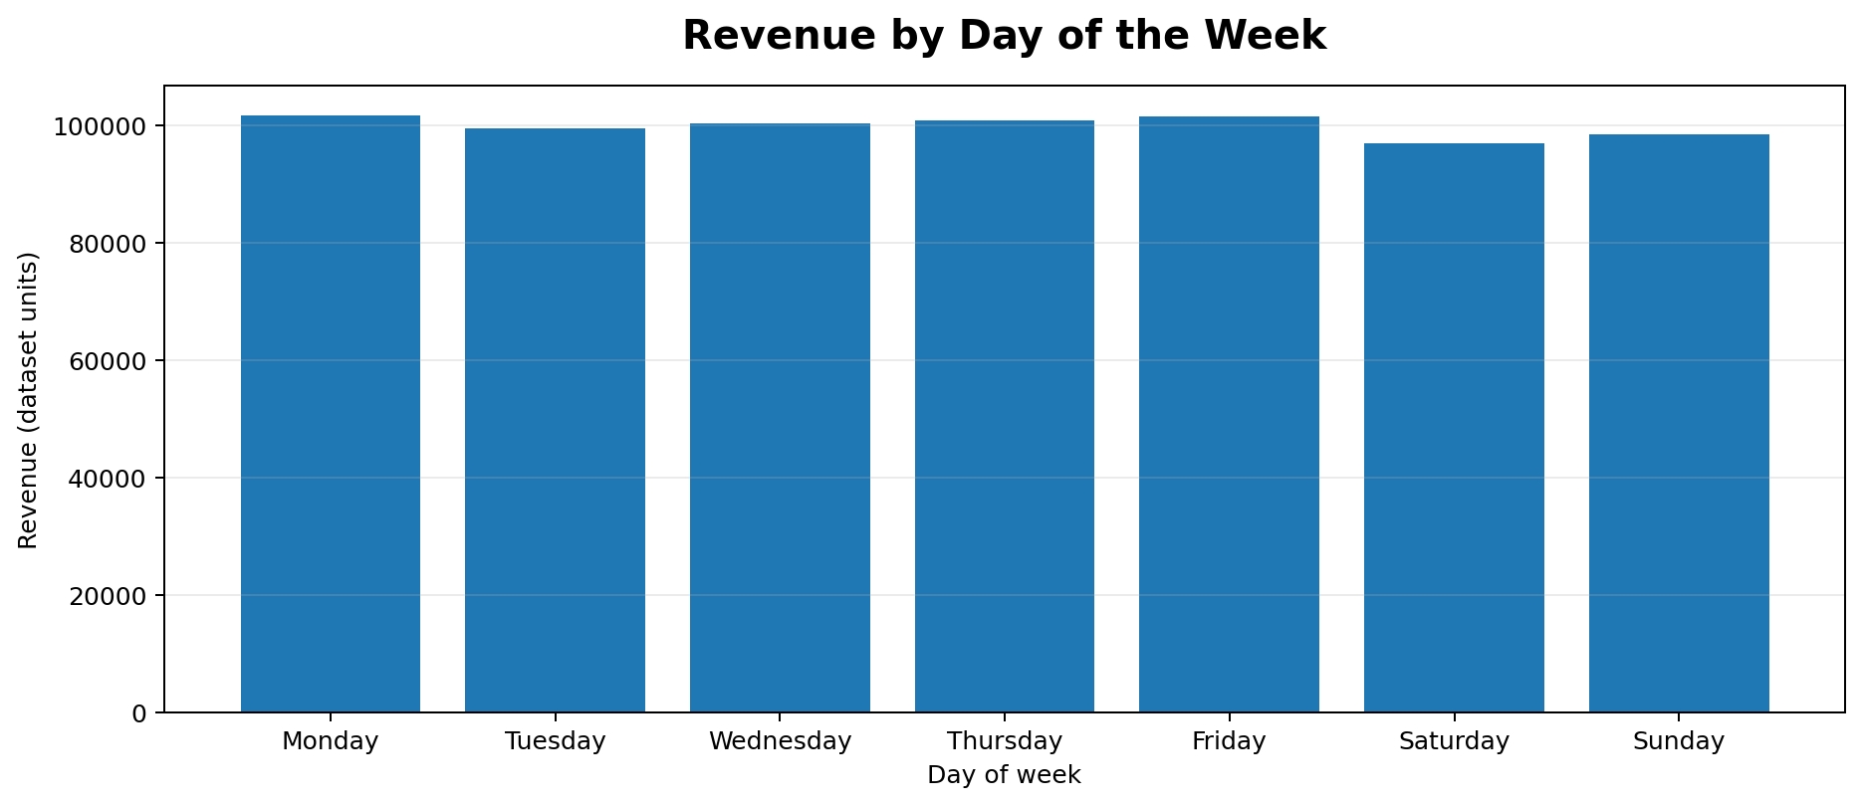
19. Revenue by Day of the Week
Compare total revenue across weekdays to identify stronger and weaker trading days.
Key finding: Highest day: Monday (101,677.28). Lowest day: Saturday (96,894.48).
Source: Bright Coffee Shop Sales dataset | January–June 2023

Slide 22
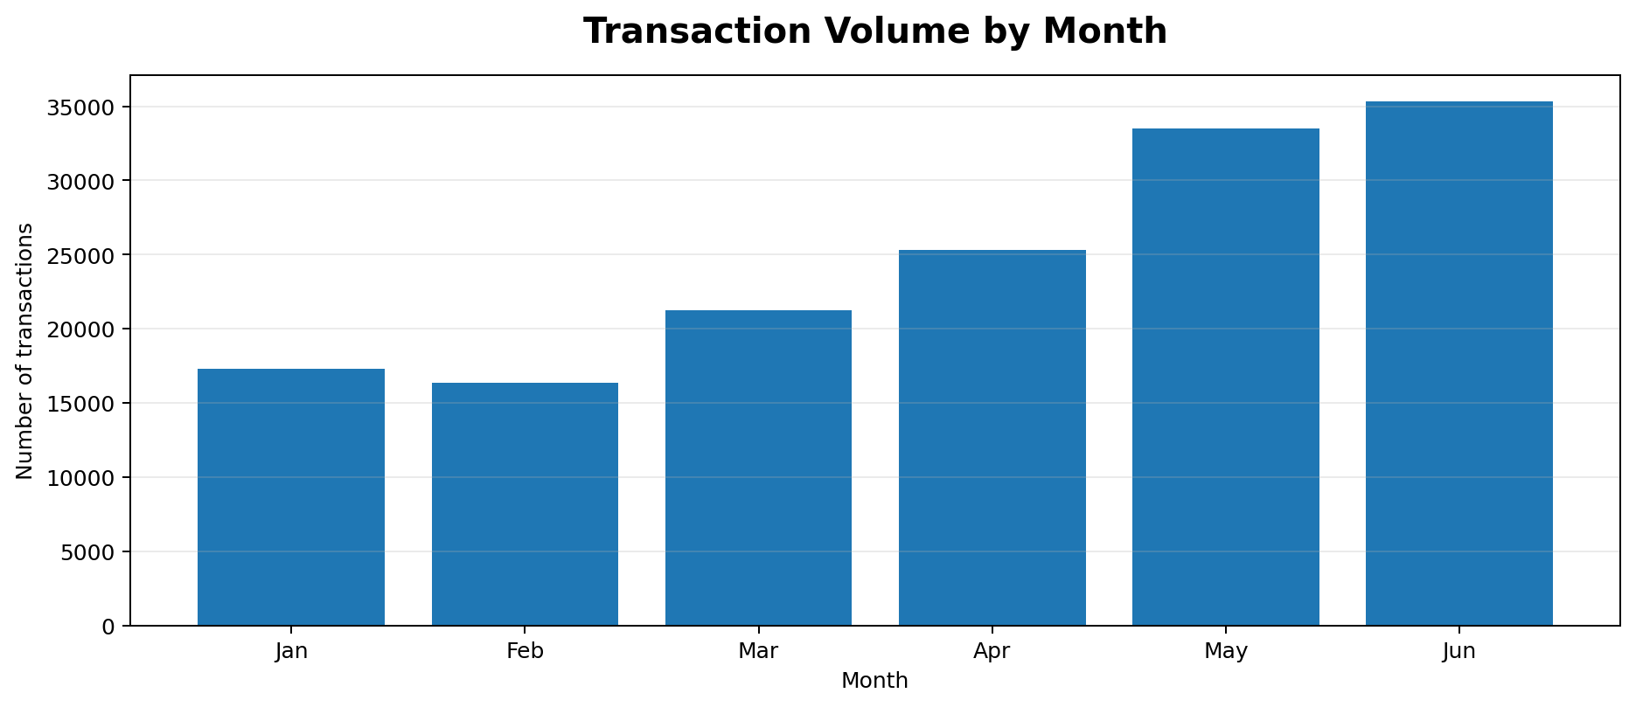
20. Transaction Volume by Month
Transaction counts show whether the revenue trend also reflects changes in customer activity.
Key finding: Highest transaction month: Jun (35,352 transactions).
Source: Bright Coffee Shop Sales dataset | January–June 2023

Slide 23
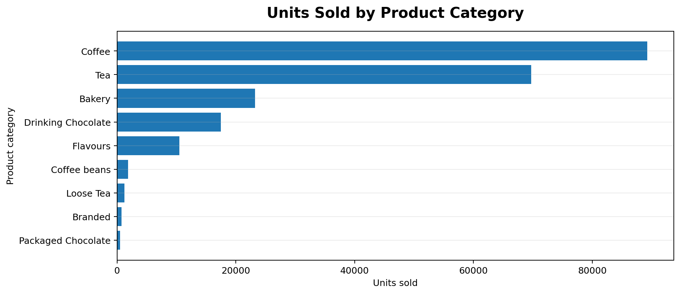
21. Units Sold by Product Category
Unit volume complements revenue: a category can sell many items without having the highest revenue per item.
Key finding: Highest unit volume category: Coffee (89,250 units).
Source: Bright Coffee Shop Sales dataset | January–June 2023

Slide 24
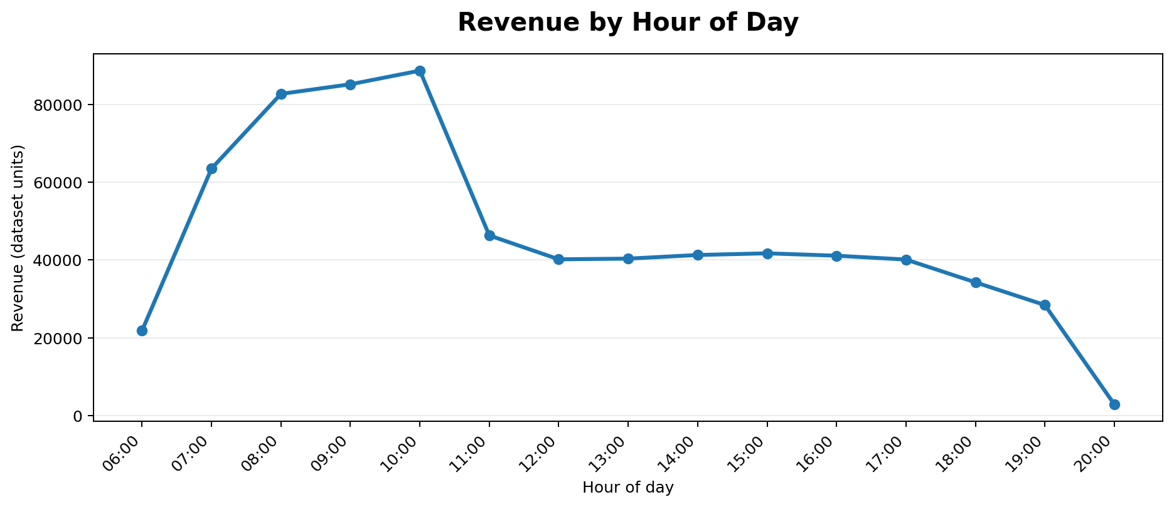
22. Revenue by Hour of Day
Hourly revenue helps inform staffing and product-preparation decisions during busier periods.
Key finding: Peak revenue hour: 10:00 (88,673.39).
Source: Bright Coffee Shop Sales dataset | January–June 2023

Slide 25
CONCLUSION
Turning sales data into business insight
This project demonstrates how transaction data can be prepared, analysed with SQL, summarised in Excel and communicated through visualisations. The main trend is stronger monthly revenue toward the end of the reporting period.
Thank you
Questions and discussion
BRIGHT COFFEE SHOP SALES ANALYSIS | JAN–JUN 2023 16

Slide 26
QUESTIONS?
Bright Coffee Shop Sales Analysis
January – June 2023
Prepared by: Neo Kole
BRIGHT COFFEE SHOP SALES ANALYSIS | JAN–JUN 2023 17

